Slide 1
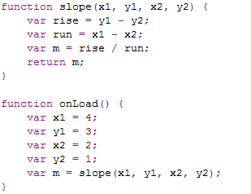
Functions have their own parameters and variables

Slide 2
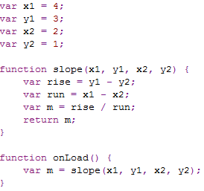
Parameters and local variables are found before global variables
Global variables
Local
variables

